Slide 1
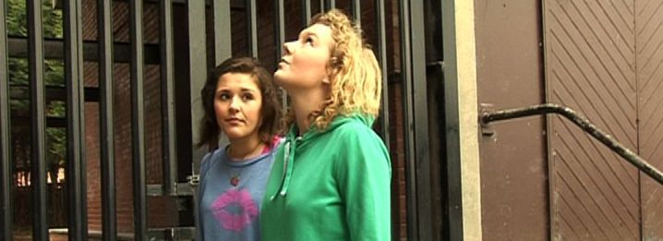
How did you use new media technologies in the construction and research, planning and evaluation stages?
Lorna Beecroft.
NewGenerationProductions.

Slide 2
Introduction
Lorna Beecroft.
NewGenerationProductions.
Digital technology was one of the main subjects which helped us along the process of film making. There are four different phases in which we went through, involving the use of new media technologies. These phases were; researching, planning construction and evaluation. Research is the stage of gathering information to help us gain experience to make a better film, there was a variety of different technological research which had to go into our production, so technology played a huge part at this stage. Planning blends in with the research part nicely and so wasn’t a big change in the process of making the film, which worked nicely, this involves bringing all the evidence together to improve how the film is seen at the end. Construction is the biggest step in the process, as this includes the different types of digital technology whilst making the film along with the evaluation which brings the finished film together to show to an audience.

Slide 3
Research
Lorna Beecroft.
NewGenerationProductions.
When researching for this production we came across a range of new media technologies such as youtube This was to evaluate a short film we viewed in order to create an idea of what our film was going to be produced like. Youtube is an international website in which anyone can sign up to, to upload their video of choice and people from around the world (or your choice) can view your video. So for this intention, finding a short film to evaluate was quick and simple. Youtube is easy to navigate around and certainly not complicated in the slightest to search for the video of your choice. For this reason the researching process already was great to come to terms with, which meant it improved the working process for our group, as the evaluations were done in no time. We also used our teacher’s website to choose from a few of the best short films there is to evaluate and read through information when updating our websites etc. This website enhanced our knowledge much further because it meant we could easily find information to help us achieve the best evaluation possible.

Slide 4
Planning
Lorna Beecroft.
NewGenerationProductions.
When planning our short film we used websites such as weebly. This is a website in which our group owned to hold together all the work and information on our project. Our group found this much easier for handling our coursework and different paper work because it meant that no work could be lost, aswell as the fact if any data needed editing it would be much quicker to change from opening up the files from Weebly. Another benefit for holding this website is that our group could view each others work and help improve on adding in each others thoughts to the information. Here is our groups Weebly website: NewGenerationProuctions . This built up our team work so in future projects we’d know we have each others help. Our script was developed by Celtx, this is the first all in one pre-production system, it is specialized for creating media projects such as screenplays, films, comics etc. The programme also includes LaTeX, so templates and printing options are provided. By using Celtx this created a much better look for our script and helped design it into a more professional look, which added more motivation to the group as we wanted to maintain this standard of work. Together we also explored using other media technologies such as digital cameras to create our animatic. An animatic is a digital storyboard, that creates the narrative of the film in simple digital pictures, with added music and non-diagetic sound. This is a lot more clearer and stronger developed than a normal storyboard and enables an audience to form a better outlook of what the film is going to be like. We produced both a storyboard and animatic through our process of film making and the animatic was less complex but more understandable, and we felt the audience also found this too.

Slide 5
What is the benefit of creating an animatic? And what is the benefit of using this technology during the planning stage?
Lorna Beecroft.
NewGenerationProductions.
By creating an animatic this helps get audience feedback much more informative as they know more about the film and can discuss if they think something is being perceived wrong. Because an animatic creates the exact narrative and insight to each character as we’d like to show in the actual film, we can see clearer what we need to add or remove from a frame or how to differ an angle and make it feel right. This way, after we have received audience feedback we could then decide what needs changing before we start any filming and show improvement and development to create a better film.

Slide 6
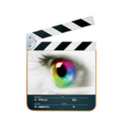
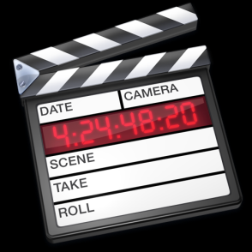
Construction and evaluation
Lorna Beecroft.
NewGenerationProductions.
When constructing our film we used a range of different digital technologies, such as the college miniDV camera equipment, DV camera’s are now known especially for their great use of independent filming and high quality images. The camera doesn’t take up a lot of room which especially helped the group out with travelling from locations to film our shots. The MiniDV camera equipment showed clear instructions with how to use the camera, including a tripod and microphone which could connect and disconnect, which was also incredibly useful for travelling and filming scenes which involved moving the equipment to follow the subject. Because of using miniDV, our finished film has concluded in a great quality picture which we’re all proud of, as well as thankful for being able to use the camera handheld when filming as this fitted in with how we wanted our shots to look. We used programmes on the computer such as word publisher to develop our media review, this was the most suitable programme to create the work up to famous media review standards. Included in the construction and evaluation part of editing the film we used a programme called final cut pro, we’d only ever used this programme once before and still came to terms with the procedure quickly. The college provided us with this programme which meant meeting up as a group could happen on more occasions than having to travel to each others destinations. Because we could all work with final cut pro as a group we noticed how editing takes some time with placing the shots together but also noticed how the editing procedure has changed rapidly through the years. Before digital technology came about, the editing process consisted of physically cutting and pasting together pieces of film, this was called ‘a film workprint’. When the film had been cut reasonably well, it then moved on to a procedure of the edit- decision list, by processing the negative, splitting the shots into rolls and then finalized by contact printing into the final film print or answer print. Nowadays digital technology has taken away all that hassle and formed computer programme’s (such as Final cut express and Sony Vegas) which automatically provide cut lists from a DI editor, which can be saved and worked on for however long they want. I believe this has stopped those who use editing programme’s from getting so worked up as we found it to be a much more simpler technique compared to the history of editing. In the construction stage we also used copyright free music to help inform the audience of the genre of the film and create a certain amount of emotion which i feel added a good effect to our film
Besides final cut pro, the evaluation stage also introduced the DVD burning software in which was used to place our completed short film onto a disc so that it could be viewed from different DVD players, computers etc. Because of this it means for our group to promote our film to an audience we could locate anywhere we wanted with the right digital equipment instead of bringing an audience to one specific place.

Slide 7
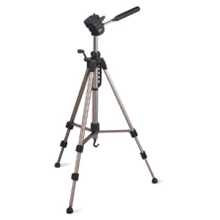
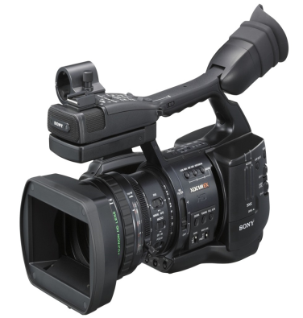
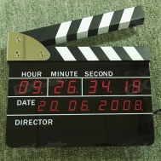
What did this technology allow you to do that you would have found hard before?
Lorna Beecroft.
NewGenerationProductions.
Technology is being improved year by year and because of the range of different digital technology around our film making skills have been improved. The camera we used to produce this film let us choose a variety of ways to make a scene more interesting, such as push and pull focus, just by the click of a button. We also liked how the camera was able to become attached and unattached to a tripod, it seems such a small idea, but tripod helped us focus on certain subjects whilst filming a lot easier. From making this short film we’ve felt much more confident about film making and it’s been a great opportunity to understand the way in which the camera works. Working as a team has also made the process much easier as we’ve helped each other with different things such as which buttons to press on the camera and how far away the sound booth should be. Before this project I wouldn’t understand how just by a tap on the sound booth could disorientate how the film sounds on the finished clip.
Digital technology has had a massive improvement on our finished film, especially with how quick and easy most of the technology is in this day. As a team we’ve realized the importance of how the framing should be and that patience is a virtue in the editing procedure.

