Slide 1
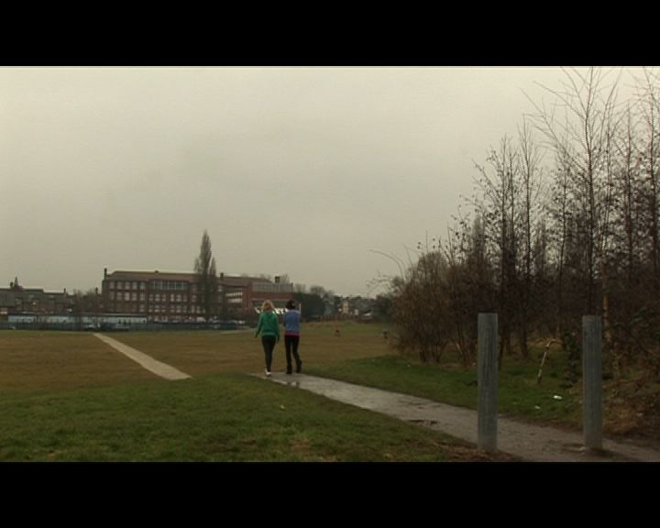
How effective is the combination of your main product and ancillary texts?

Slide 2
The functions of our radio trailer; http://www.youtube.com/watch?v=EFasmZgfc0k
and magazine review; http://newgenerationproductions.weebly.com/uploads/3/0/7/4/3074275/media_review.jpg
are to sell our product; the film. They are designed to attract our target audience; young girls ages about 13-16. In order to sell a product, the advertisement needs to be catchy and tempting and I believe our radio trailer and magazine review are exactly that.

Slide 3
Our products achieve the function of selling our film as they appeal directly to our target audience
…

Slide 4
The purpose of a radio trailer is to set the genre, draw the audience in and tell them a bit about your film.
Our genre is teenage drama and the voice we chose to use for our radio trailer fits perfectly. It is over the top, bold, likeable and enthusiastic.
Our films tells the story of a young teenage girl; Emily, going through a dilemma, our radio trailer reveals this…

Slide 5
.. The music and dialog in our radio trailer is used to reach our target audience. It establishes our genre (teenage drama.)
The music used within our radio trailer is mellow yet sets the mood of slight tragedy. Which is what Emily is about. Both the magazine review and radio trailer tell the audience that Emily is a teenage girl with a teenage problem. This is what we wanted to portray in our ancillary texts.
The dialog used was selected for the purpose of reaching our target audience. We used an over-the-top voice with phrases which are the conventions of all radio trailers such as ‘you wouldn’t wanna miss it.’ Our radio trailer also states the rating of our film and when it is coming out.
All these things are put in our trailer with the intention of attracting our target audience.

Slide 6
A magazine review needs to be eye catching and should be designed to inform the audience about the film; it's qualities and negative characteristics, the genre and approach. The pictures and texts we chose to use on our magazine review do exactly this. http://newgenerationproductions.weebly.com/uploads/3/0/7/4/3074275/media_review.jpg
Our magazine review has the conventions of every review; release date, certificate, director, cast and a synopsis of the film. We have used these things to inform the audience about our film. The font, style of writing and pictures on our review have been particularly chosen to draw teenage girls in (our target audience.)
They tell the story of our film, without giving too much away, and attract our audiences’ attention…

Slide 7
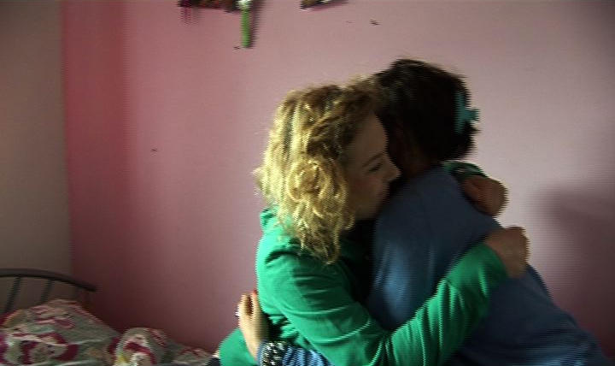
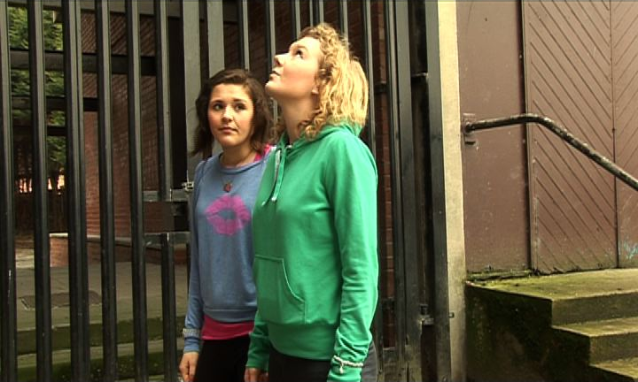
..When flicking through a magazine, for a review to make someone stop and look at it, it has to appeal to them. Which is what we did; the pictures, texts and house style of our magazine review are aimed at young teenage girls. The style of writing we have chose to use is not too complex yet fits a teenage girls’ vocabulary ‘not to be missed.’ The language used in our review has the purpose of enticing our audience want to watch our film; ‘the audience will be creating all kind of different scenarios in their heads to what could happen.’
The pictures we chose to use on our review ;
We believe these pictures best encapsulate the film because Emily is a story of fear and friendship and these pictures reveal these emotions, and will make our audience want to read more about it. They also best relate to teenage life.

Slide 8
Emily is a teenage drama exploring fear and friendship. Our main product and ancillary products both portray these emotions.
Fear and friendship are the main components of our main product; therefore it was a necessity that they came across in our ancillary products.
We achieved to convey this theme with various different resources used in our ancillary products such as the pictures in our magazine review. The pictures best tell the story of Emily, one being a supporting hug from a friend, and the other looking up at a building with anxiety. The main components certainly come across here.
Our radio trailer actually says that Emily is a teenage drama exploring fear and friendship, these audience know straight away here that’s that what the film is about.
These emotions bind in nicely together in our ancillary tasks as they support each other within our ancillary products.
The voice used in our radio trailer has a dramatic tone yet accompanying it is the protection of friendship mentioned throughout.

Slide 9
The similarity between the two products is that they are both trying to sell our film, which is there purpose, connotation being those products need to have certain characteristics in them that will attract our audience.
The voice in our radio trailer, the pictures in our magazine review and the non-diegetic sound in our film all are there to sell our film.
The link between genre; teenage drama, is achieved in our radio trailer, as is an outline of the main product.

Slide 10
I think the combination of our main product and ancillary texts is very effective as they both give our viewers an anticipated feeling.
The ancillary products advertise our film, and our main product explores some of the journeys of teenage life.
Drama is all about anticipation, waiting to see what happens next and the genre we selected for our film is effectively represented in our ancillary products.

